Slide 1


Survey on online and distance learning
Prepared and presented
by Vikas And Its Team Members

Slide 2


Team Members
VIKAS (2019UMC4555)
ADITYA (2019UMC4556)
HARSH DAHIYA (2019UMC4535)
CHIRAG LAKRA (2019UMC4534)

Slide 3


Introduction
Project Goals
Participates In Survey
Aim Of Questionnaire
Respondents
Education Wise
Gender Wise
Online Teaching and Learning Tools
Student Satisfaction
Outcome's of the survey
Future Of Online Learning
Conclusion
Report & file links
Table Of Content

Slide 4

Introduction

Slide 5


Due to the COVID-19 pandemic, millions of college students made the shift from in-person to virtual learning in 2020 & 2021.
Although distance learning offers obvious advantages for both teachers and students, such as continuity, flexibility, and mutual support, many teachers have had to adjust to online teaching owing to the necessarily short notice. On top of that, it is difficult for teachers to ensure that all pupils, especially the disadvantaged and young ones, will stay engaged and take part in classes online.

Slide 6
This survey is to explore opinions on online and distance teaching/learning from across India from the point of view of students, teachers, and parents using different sets of questions according to the category the user belongs to.
Basically, with the help of the survey, we are finding whether the respondents want to continue with the currently ongoing distance teaching/learning or they want to shift back to the general mode that is offline mode as the situation gets normal or they want the blended mode of teaching/learning which includes online + offline both.
Also, we are finding out what are the advantages and disadvantages respondents faced while having distance learning/teachings and whether it affected them or not. And what measures should be taken to improve this type of learning if the conditions do not get well?

Slide 7
Project Goal

Slide 8
This Report, which provides both student, teachers, College, Parent, and school administrator perspectives, offers the most current view of online education, including a look at remote learning experienced in the wake of COVID-19. This year’s student participants included online students, remote learners, graduates of online programs, and prospective online students.
This report presents the online teaching-learning tools, methods, and a survey on the innovative practices in teaching and learning. Advantages and obstacles in online teaching, various components on the effective use of online tools, team-based collaborative learning, simulation, and animation-based learning.

Slide 9
Participates In Survey

Slide 10
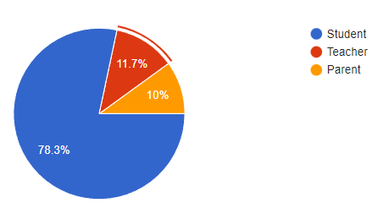
01
In the first survey, our team connected with schools and college students to know about their feedback via the Google Form platform. This year we reached 45 participants, representing current remote and online learners, prospective online students, and online degree program graduates. These participants responded to questions about their learning experience, motivation and expectations, and overall satisfaction.
Three online surveys were conducted to participate
02
The second survey collected information from teachers. This year we reached 5 participants, representing current remote and online learners, prospective online teaching. These participants responded to questions about their learning experience, motivation and expectations, and overall satisfaction.
03
The Third survey collected information from parents. This time we reached 5 participants and These participants responded to questions about their learning experience, motivation and expectations, and overall satisfaction.

Slide 11
Aim Of Questionnaire

Slide 12
The questionnaire aims to identify the effectiveness of various online tools and technologies, the preferred learning methods of students, and other factors that might influence the teaching-learning process. The parameters were based on different types of learners, advantages, and obstacles to online learning.
Section A Questions are demographic question that helps to know about Respondent
Section C Questions are used to comprehend the learning style of the student and to identify the various barriers to online learning faced by students etc.
Section D Questions are used to identify the various barriers faced by teachers during online learning and also used to find out the effectiveness of the medium used by teaching for teachers.
Section E Questions are used to identify the difficulty faced by parents

Slide 13
Shows The Education -Wise Respondents

Slide 14
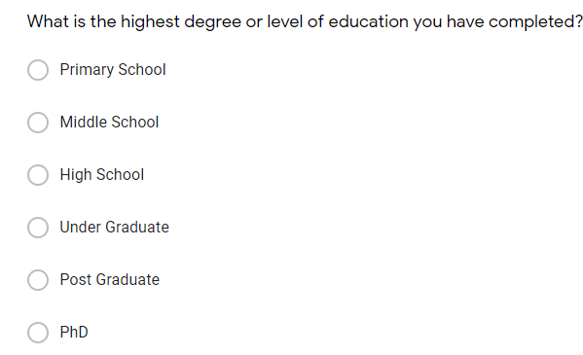

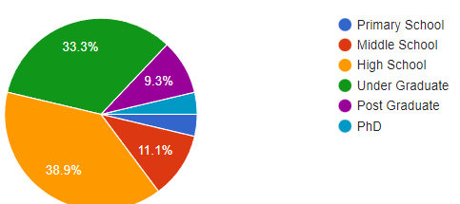

Slide 15
Shows The Gender -Wise Respondents

Slide 16

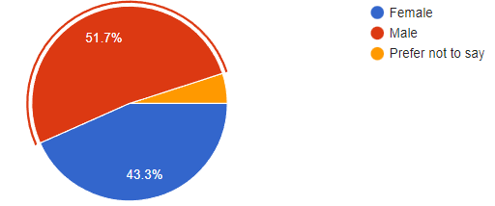


Responses of Male Respondent is more than female Respondent

Slide 17
Online Teaching and Learning Tools

Slide 18
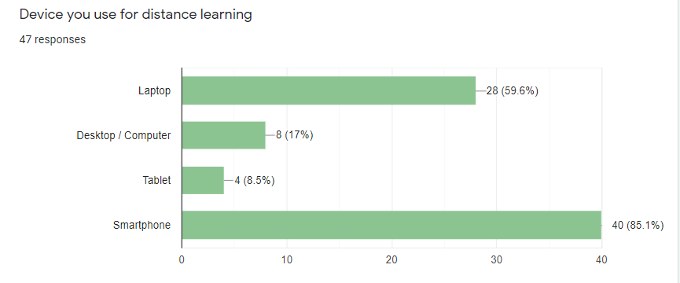
Student Point Of View: 59.6% of the respondents use a Laptop, 17% of the respondents use a Desktop, 8.5% of the respondents use tablets, and the rest 85.1% of the respondents use smartphones for distance learning.

Slide 19
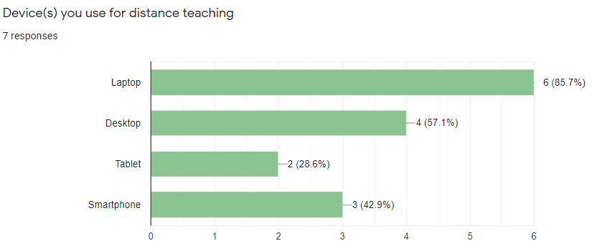
Most of the respondents use their Laptops for teaching followed by desktops, smartphones and Tablet.

Slide 20
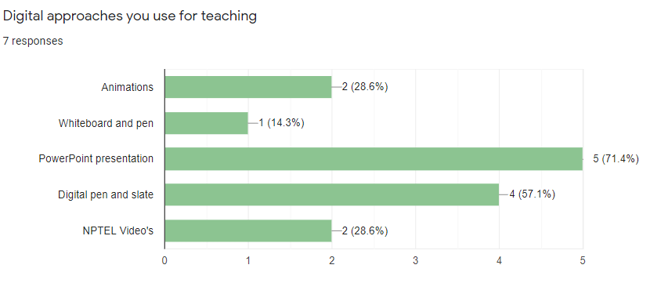
Among the respondent's majority use PPT as their approach to teach in online classes followed by Digital pen and slate, Animations, NPTEL videos, etc.

Slide 21
Student Satisfaction

Slide 22
we explore student satisfaction with online learning through four lenses related to:-
(1) How helpful your [School or University] has been in offering you the resources to learn from home?
(2) How helpful are your teachers in online classes?
(3) Is the Online Education grading system biased?
(4) Does COVID-19 pandemic affect your education in any way?

Slide 23
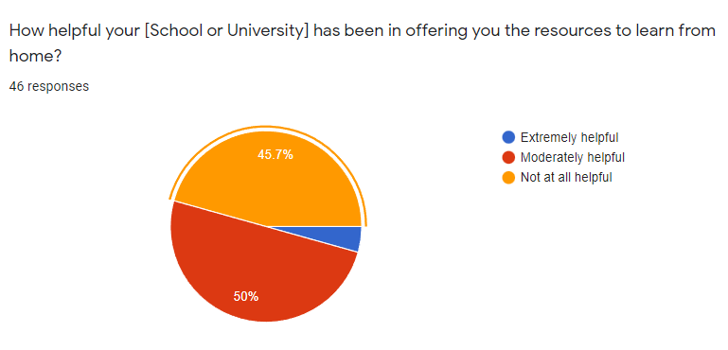

Slide 24
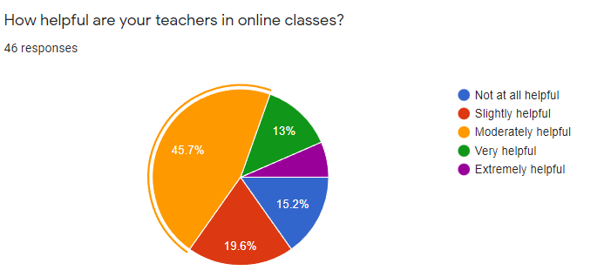
only 13% of students suppose their teachers are helpful in online classes.

Slide 25
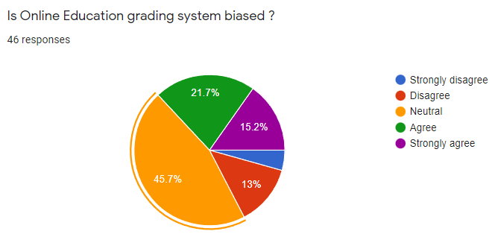
15.2% of respondents strongly agree that the Online Education grading system is biased whereas only 4.3% of respondents strongly disagree with it.

Slide 26
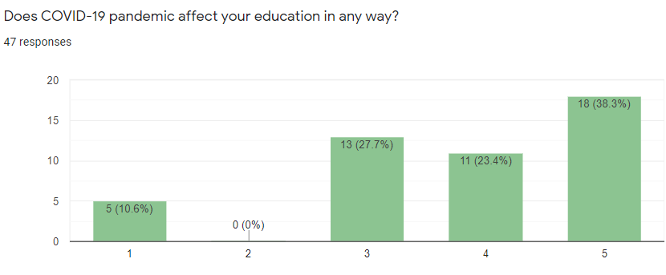
10.6% of the respondents are not at all affected and 38.3% of the respondents are most affected.

Slide 27
Outcome Of Survey

Slide 28
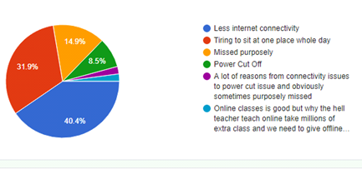
As you can take online classes very easily from anywhere if still you miss them then what are the reasons for missing an online class?
For the majority of the respondents(40.4%) the reason for not being able to attend the online class is Less internet connectivity and 31.9% of respondents think that it is tiring to sit at one place whole day in front of the screen and that's the reason they miss classes.

Slide 29
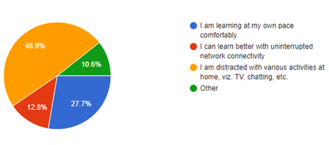
My experience with online learning from home.
The majority of students have felt distracted by other stuff like TV, Chatting, etc during their online lectures.

Slide 30
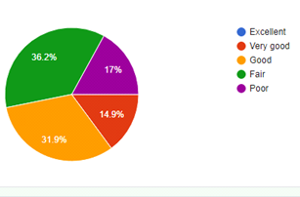
Your overall experience about remote learning
For 0% of respondents, the overall experience of remote learning is excellent. For 14.9% it was very good, for 31.9% it was good but for 17% it was a poor experience.

Slide 31
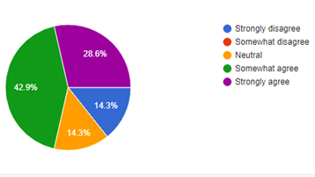
Does this pandemic affect students' mental health
28.6% of teachers respondents strongly agree that this pandemic affected students mental health whereas 14.3% of respondents strongly disagree with the same

Slide 32
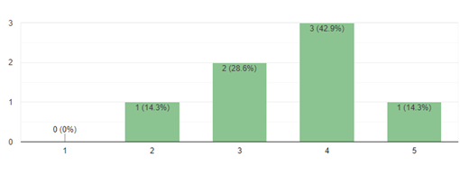
How much does the online Education System affect Your Teaching Style?
1 represent strongly disagree whereas 5 represents strongly agree for the side chart.

Slide 33
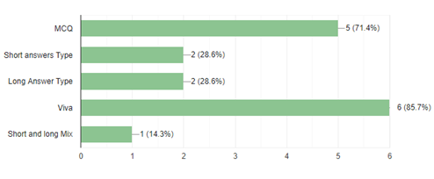
Type of assessment you prefer for testing students ability during remote learning
During remote learning, 85.7% of the respondents use Viva as testing mode followed by MCQ with 71.4%, Short answer with 28.6%, Long answer type with 28.6%, short and long mix with 14.3%.

Slide 34
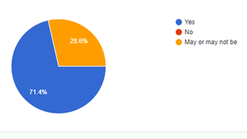
Do you think students cheat in online exams
71.4% of respondents believe that students cheat in online exams. 28.6% are not sure about it and 0% of respondents think that students do not cheat in online exams.

Slide 35
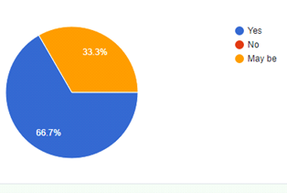
Are Your child is being well prepared to continue his/her education In Online mode?
According to parent's 66.7% of respondents, their child is being well prepared to continue his/her education in online mode.

Slide 36
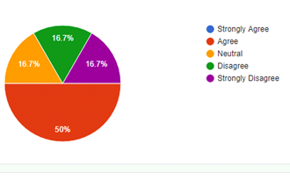
Do you think your child's educational program is of high quality to study in online mode?
50% of the parent's respondents agree that their child's educational program is of high quality to study in online mode.

Slide 37
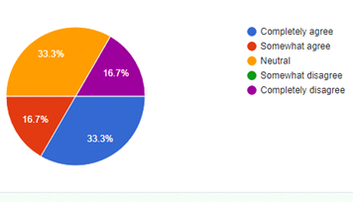
Do you find that academic work in online mode takes up most of your child's time and hence prevents them from enjoying other activities that they enjoy?
33.3% of respondents completely agree that academic work in online education takes most of their child's time and hence prevents them from enjoying other activities that they enjoy.

Slide 38
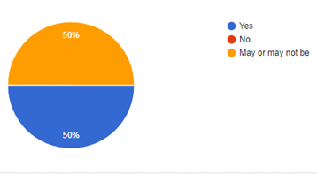
Do you think that online classes affect the quality of your child’s education?
50% of respondents say that online classes affect the quality of their child's education whereas 50% of the respondents are not sure about it.

Slide 39
Future Of Online Learning

Slide 40
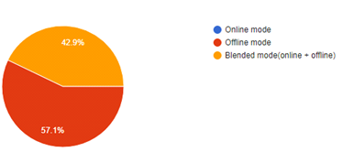
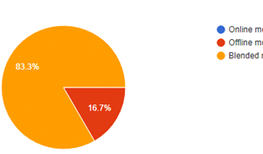
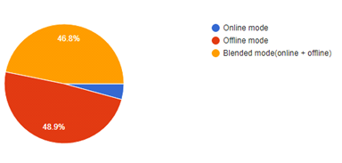
TEACHER'S POINT OF VIEW
Education mode you would prefer in future
STUDENT POINT OF VIEW
PARENT'S POINT OF VIEW

Slide 41
83.3% of parents' respondents want blended mode for their children and the rest 16.7% want it to be offline whereas no one wants it to be online mode.
57.1% of teachers' respondents want offline mode in the future whereas the rest 42.9% respondents want it to be in blended mode.
48.9% of students respondents want offline mode in the future whereas 46.8% prefer blended mode and only 4.3% of respondents prefer online mode.

Slide 42
Conclusions

Slide 43
Our survey attracted around 100 respondents where approximately 78.3% are students and around 11.7% are teachers from different educational institutes and different fields including primary level, secondary level, undergrads, postgraduate, and Ph.D., and also around 10% respondents are from the parent's category.
Almost every respondent reported challenges, the most frequent being access to technology, for both pupils and teachers, and increased workload and stress working from home. Several challenges related to supporting pupils were identified, together with their digital competence – and that of teachers.

Slide 44
Respondents feel that support in terms of more educational resources would help them meet the challenges, as well as clear guidance from the Ministry of Education, together with professional development, such as short courses on online teaching and opportunities for teachers to share resources, ideas, and challenges.
These findings offer some early indications to policymakers and educational leaders that the experience of distance/online teaching and learning, although challenging, may have lasting positive effects, opening up interesting possibilities for innovation and new ways of working, especially if supported by appropriate and timely professional development.

Slide 45
Report & File Links

Slide 46
Google form Link:
https://forms.gle/e1fHQGcxdYHkpK3Z8
EDA File link:
https://github.com/Vikas2201/Survey-Report/blob/main/EDA%20Report.ipynb
Dataset:-
https://github.com/Vikas2201/Survey-Report/blob/main/Online%20Study%20Good%20Or%20Bad_.csv
GitHub Repository Link:
https://github.com/Vikas2201/Survey-Report

Slide 47




Thank you!
DO YOU HAVE ANY FOLLOW-UP QUESTIONS FOR ME?

